Slide 1
CPU Scheduler
Under the Supervision of
Professor Larry Lay

Slide 2
Project Description
Core Functionality: Python-based CPU scheduling simulation.
Algorithms Implemented: FCFS, SJF, Round Robin, Priority.
User Interaction: GUI using Tkinter framework.
Visualization: Dynamic Gantt charts via Matplotlib.
Testing and Debugging: Comprehensive unit tests, black-box testing.

Slide 3
Project Team
Mohammed Aslam
Email: mm2954@njit.edu
Kyle Kissinger
Email: kck6@njit.edu
Ahmeduddin Mohammed
Email: am3837@njit.edu

Slide 4
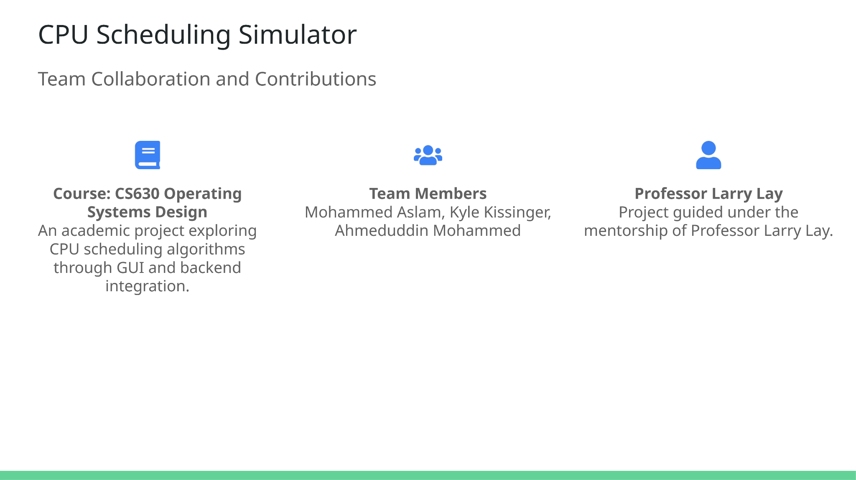

Slide 5
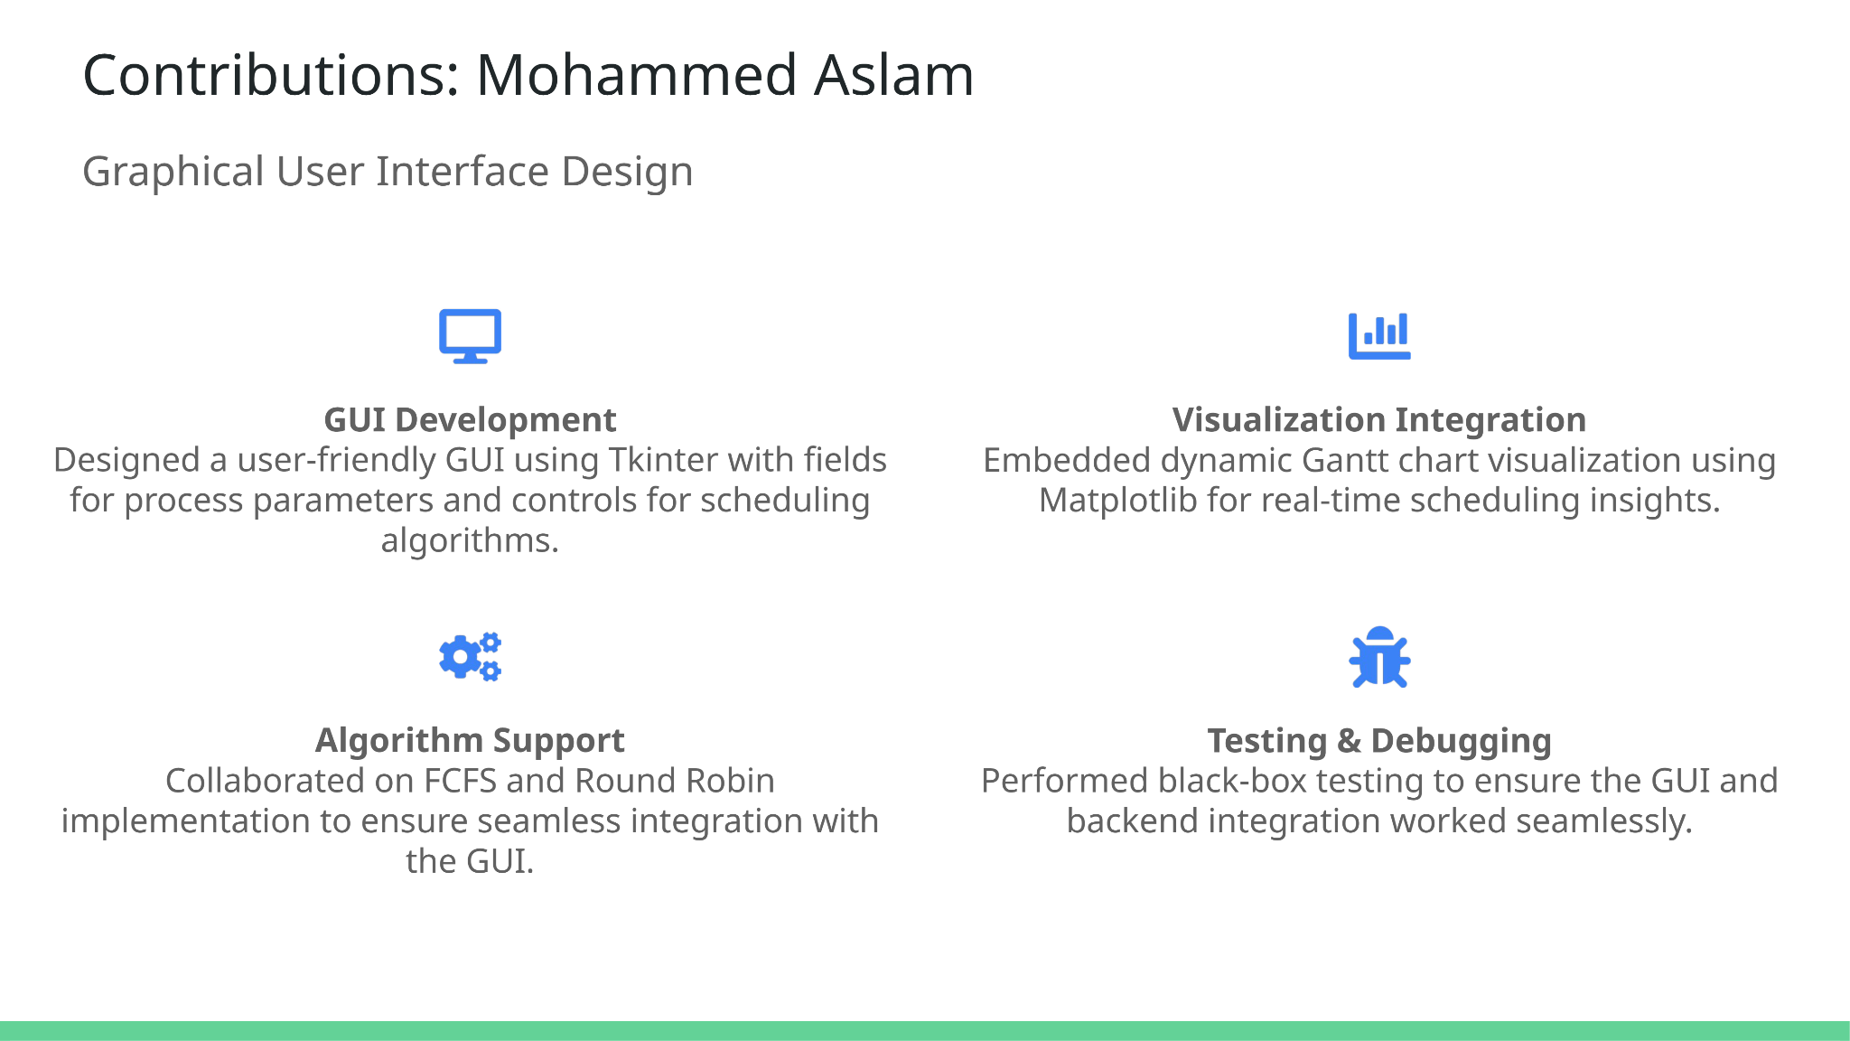

Slide 6
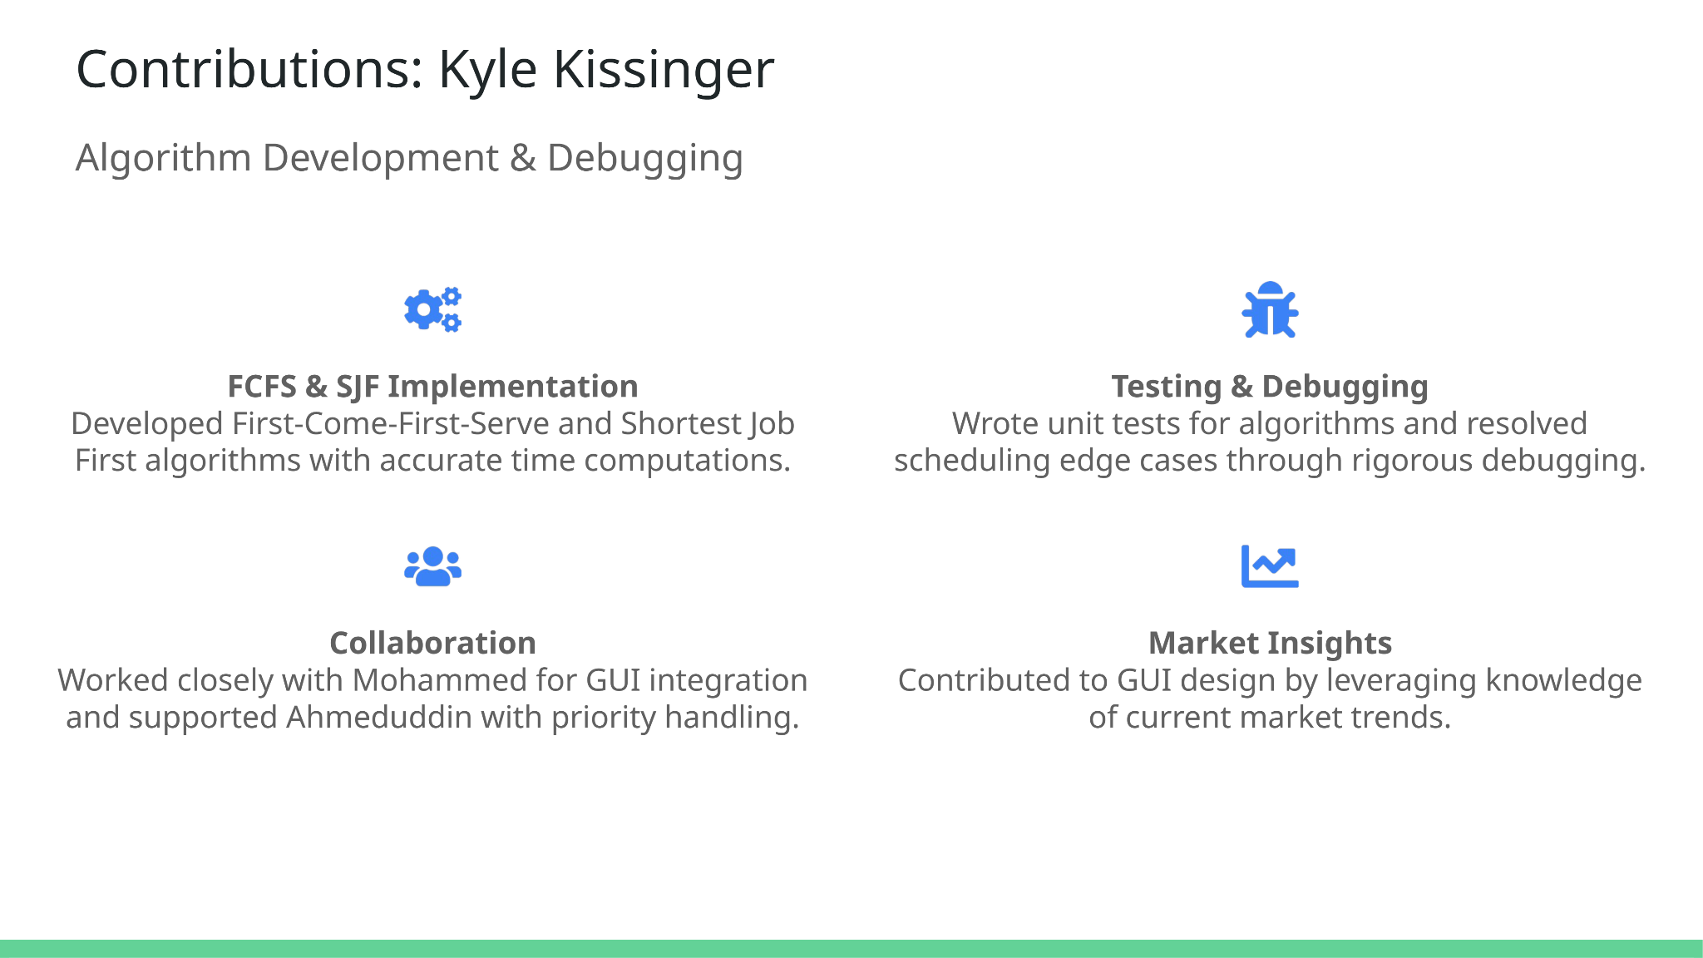

Slide 7
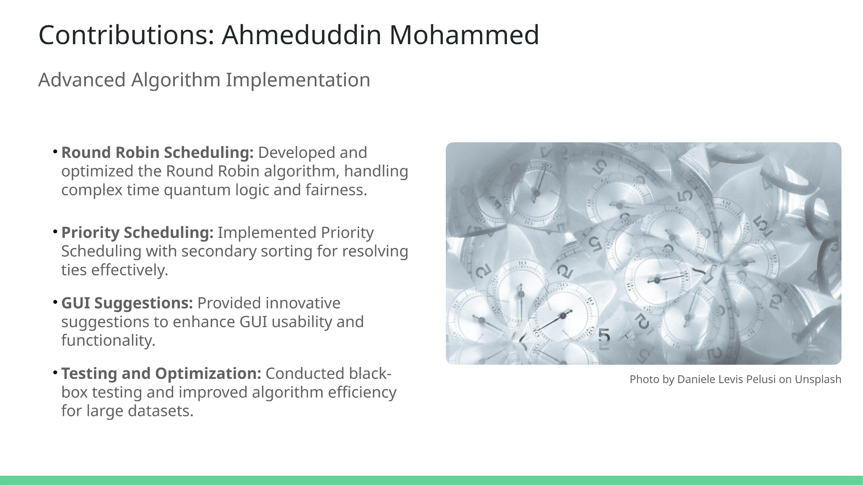

Slide 8
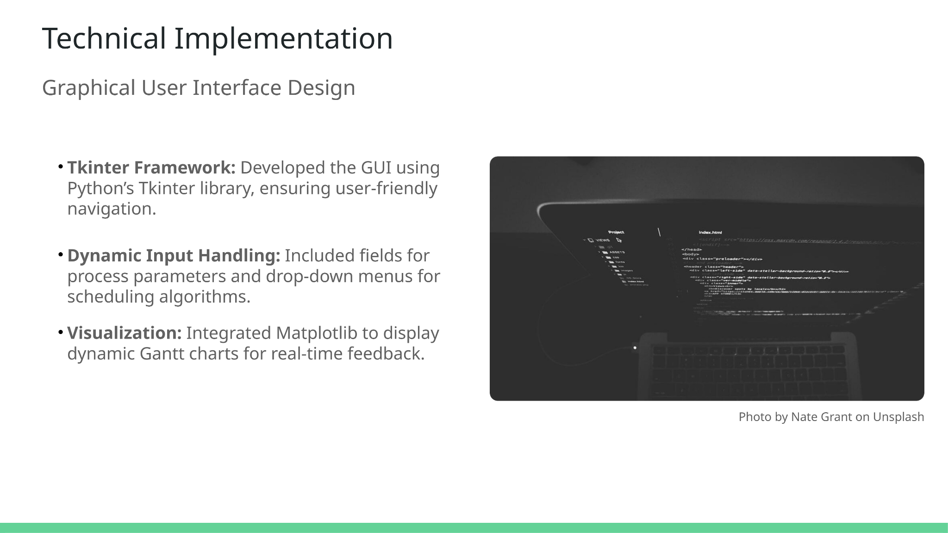

Slide 9
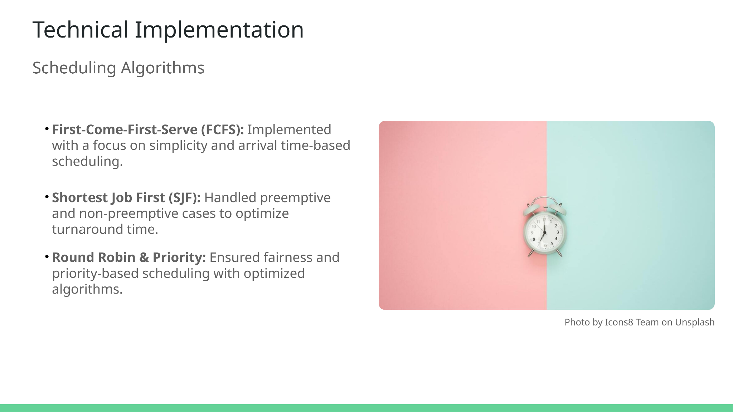

Slide 10
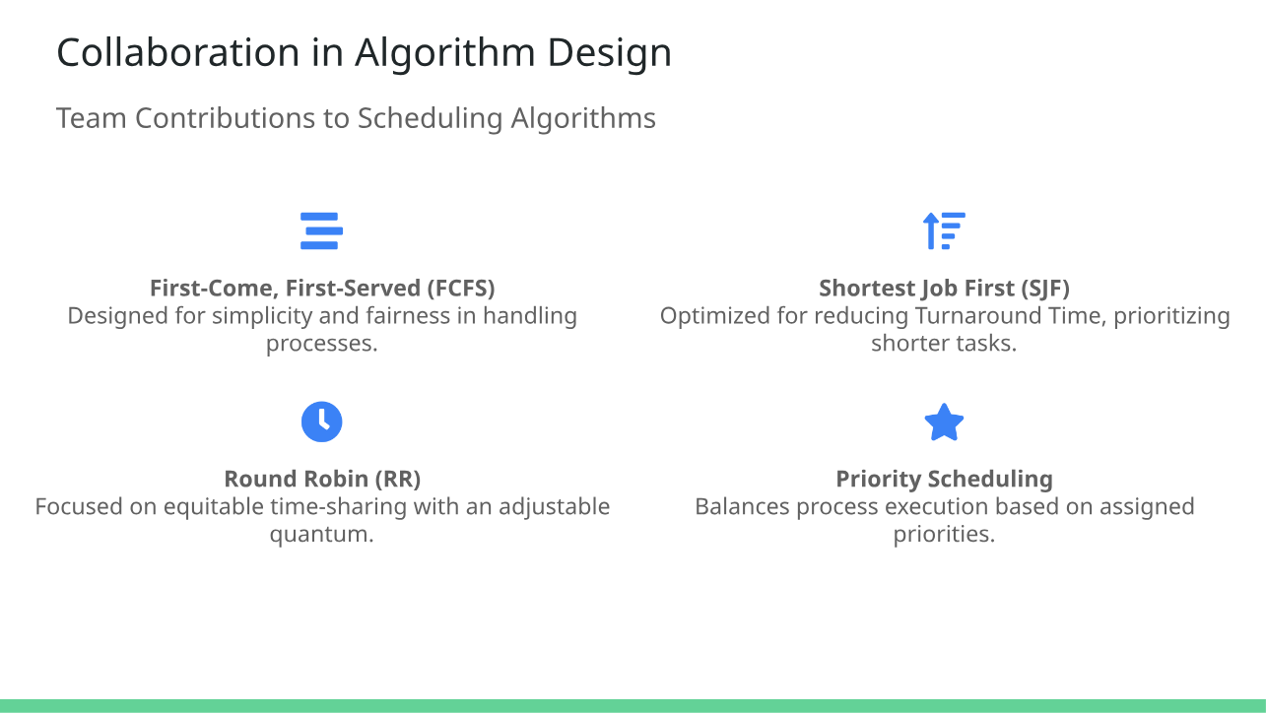

Slide 11
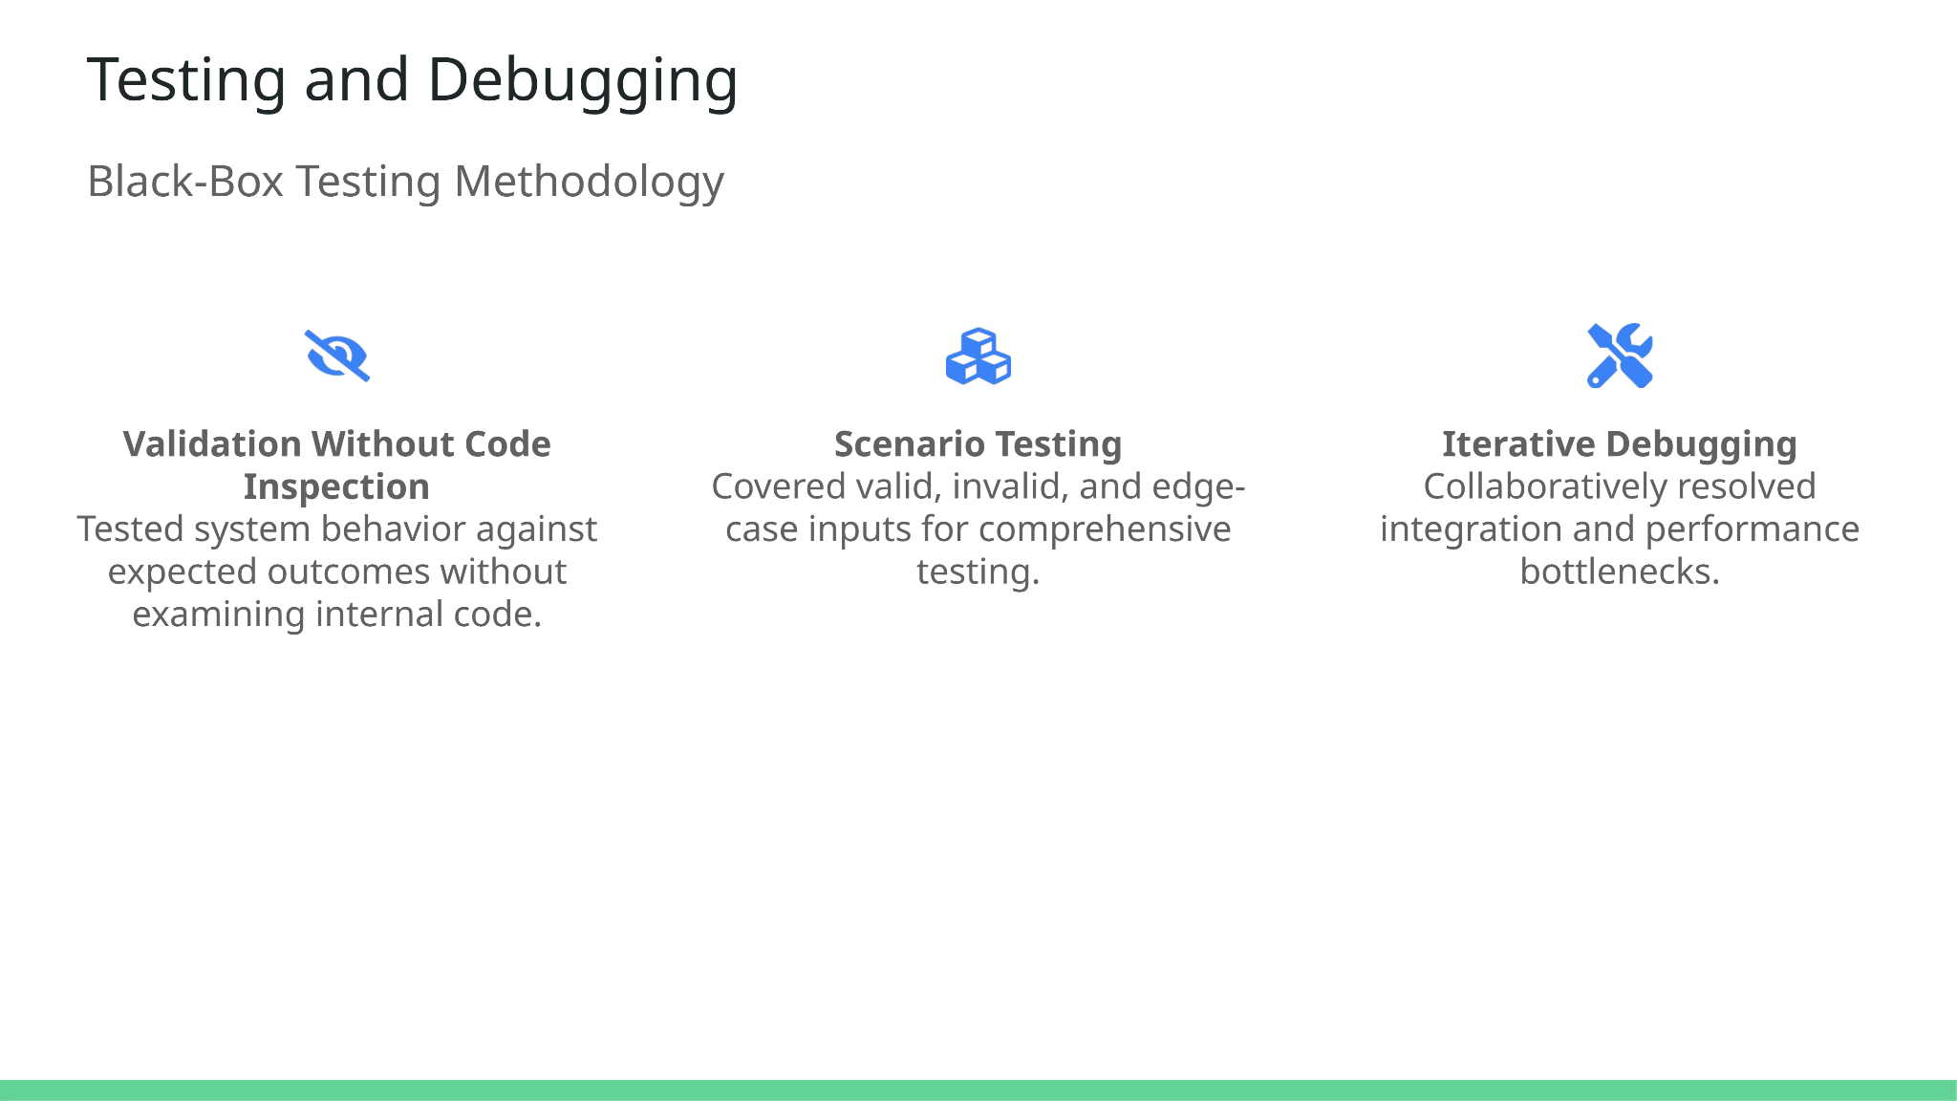

Slide 12
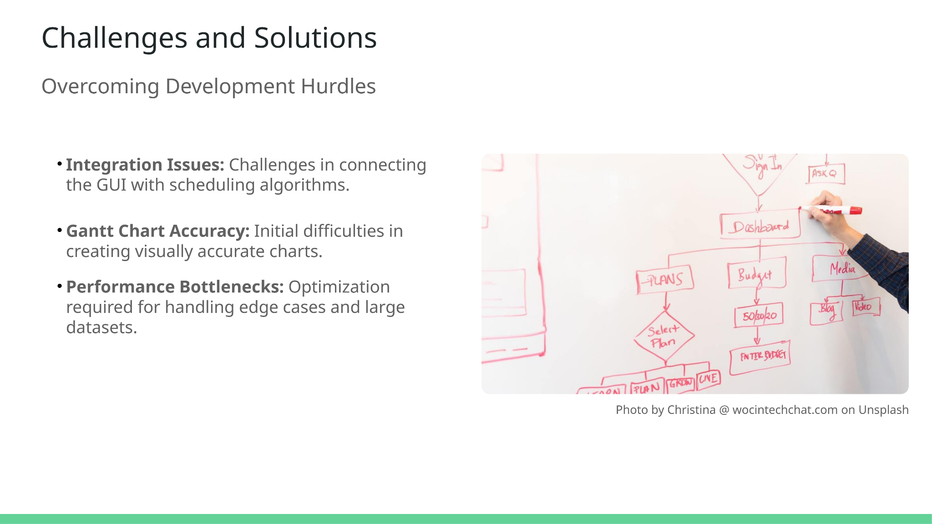

Slide 13


Slide 14
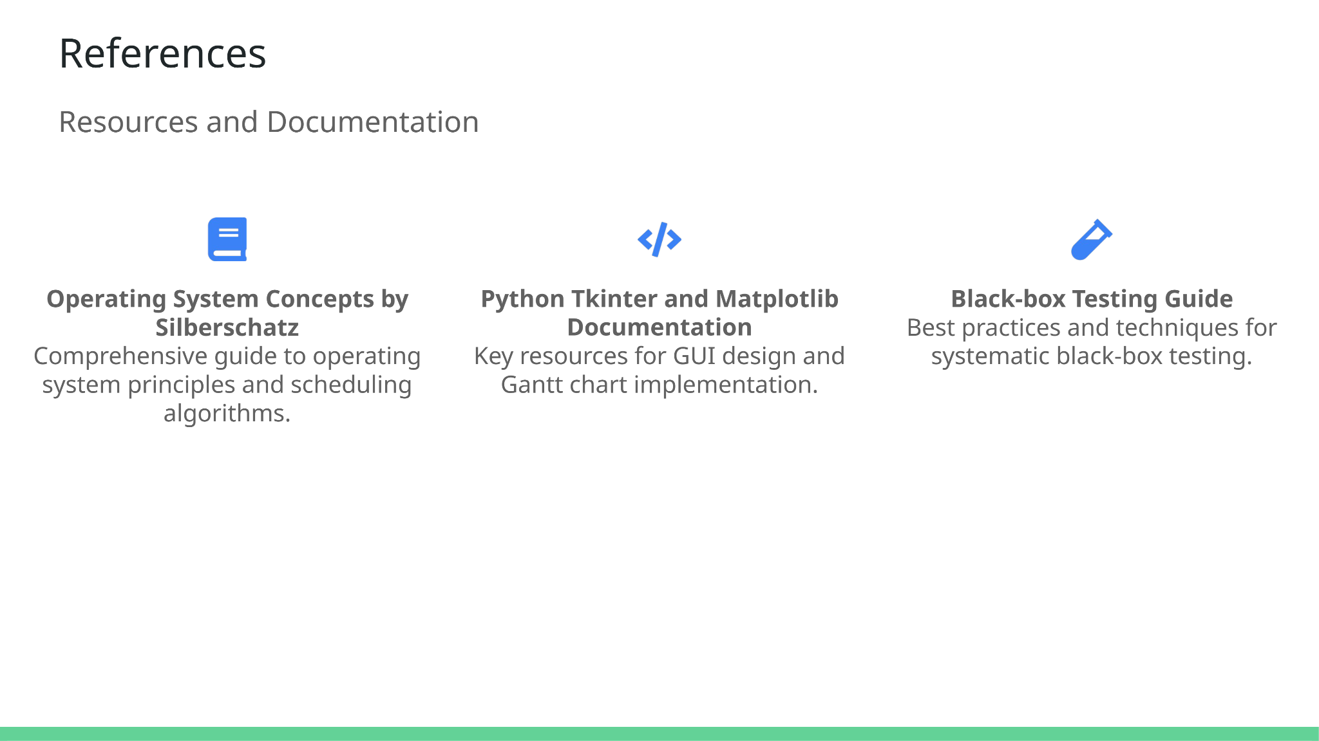

Slide 15
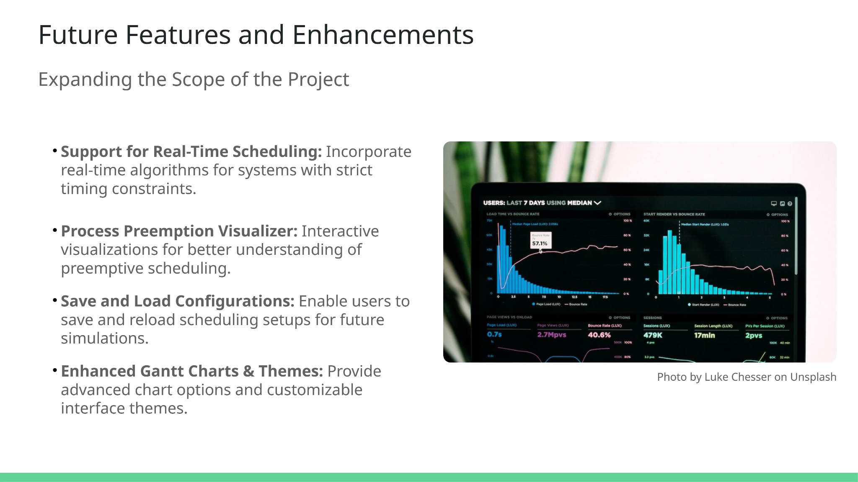

Slide 16
Code
Go to the following link :
https://github.com/MohammedAhmeduddin/CPU_Scheduler

Slide 17
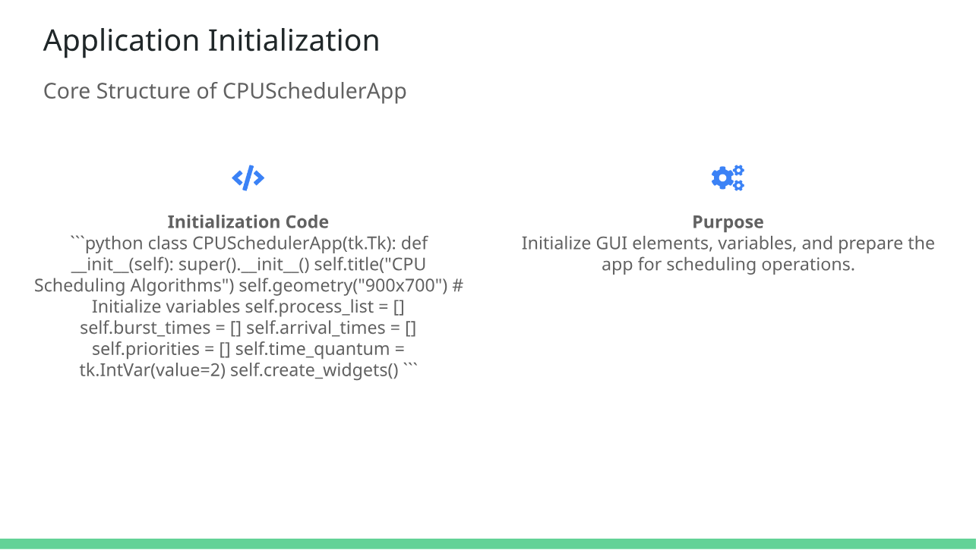

Slide 18
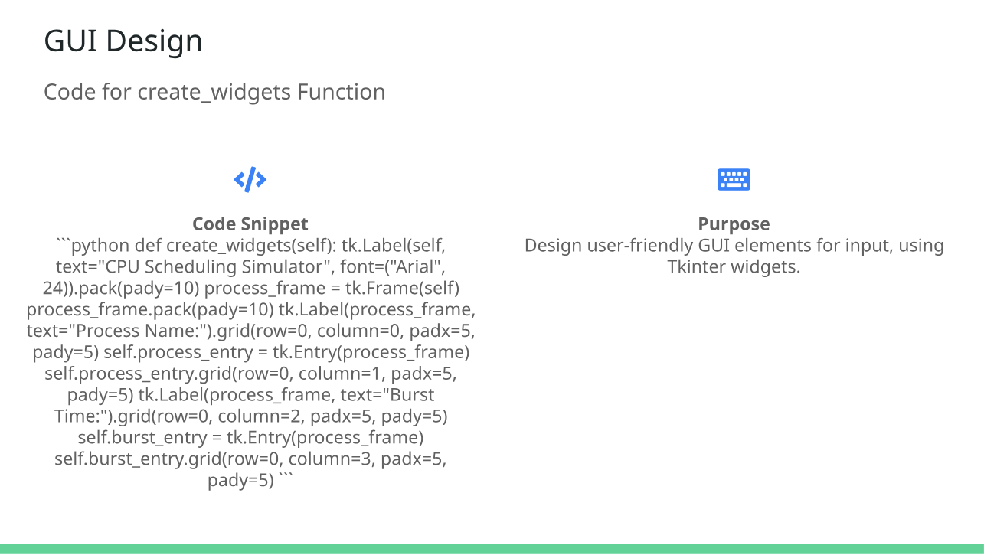

Slide 19
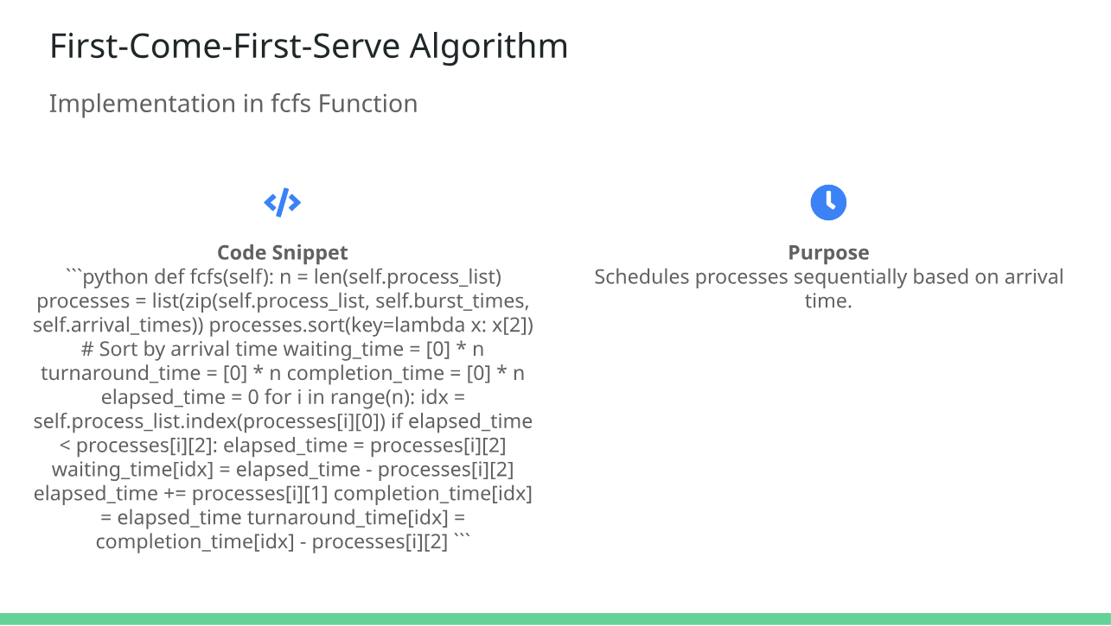

Slide 20
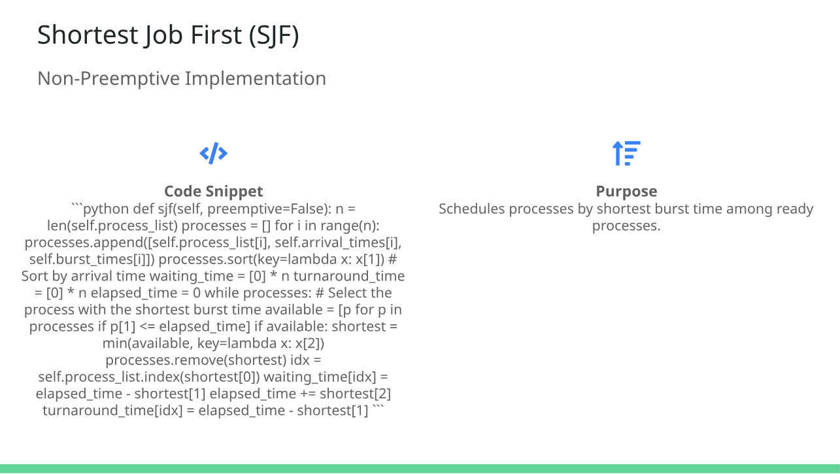

Slide 21
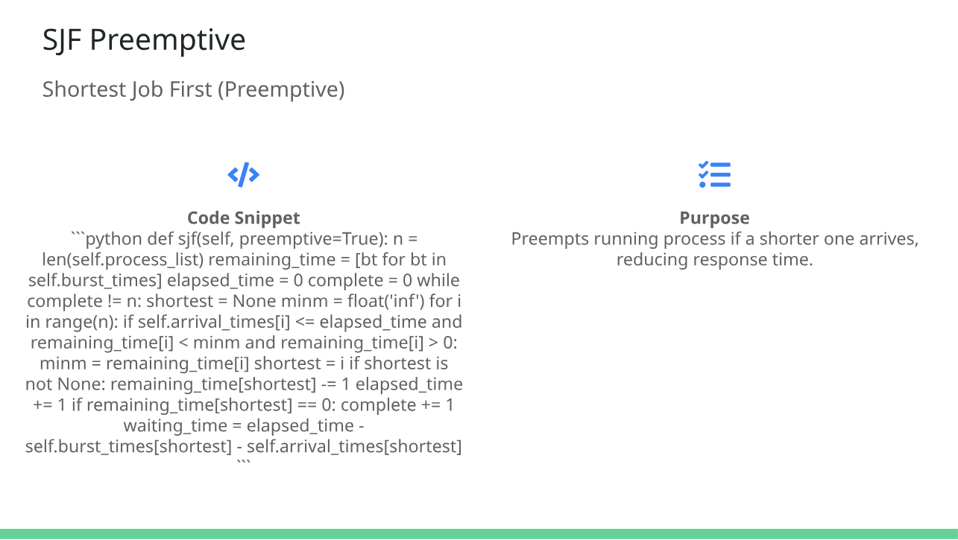

Slide 22
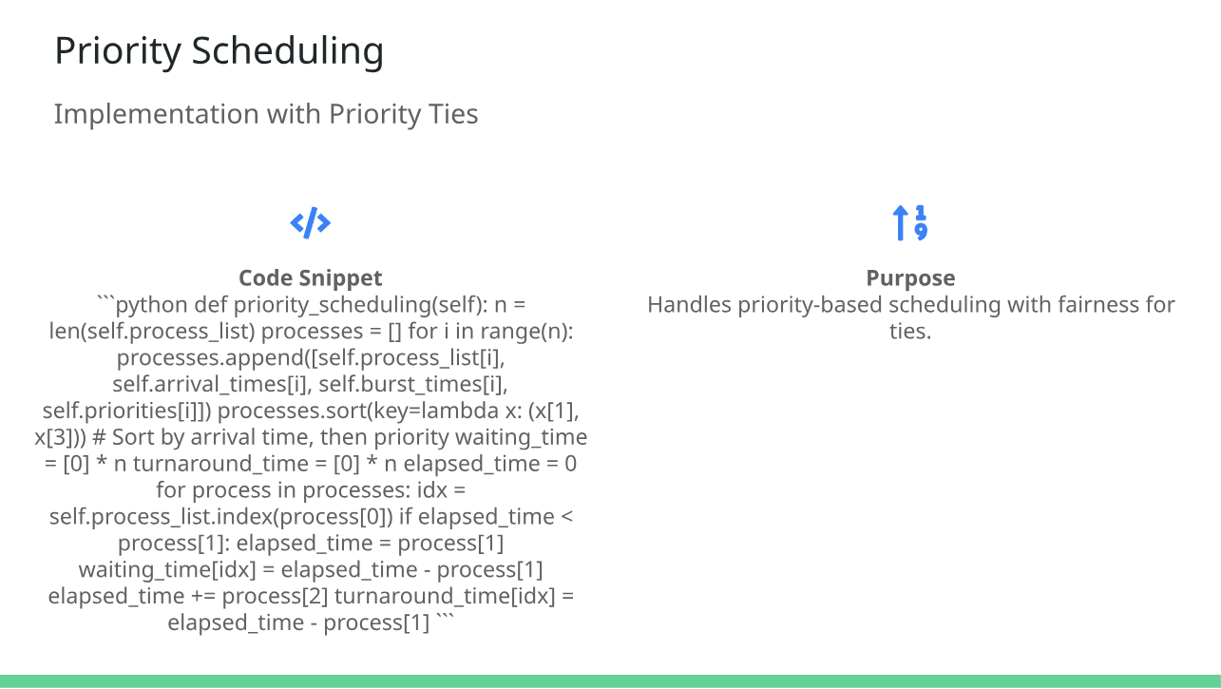

Slide 23
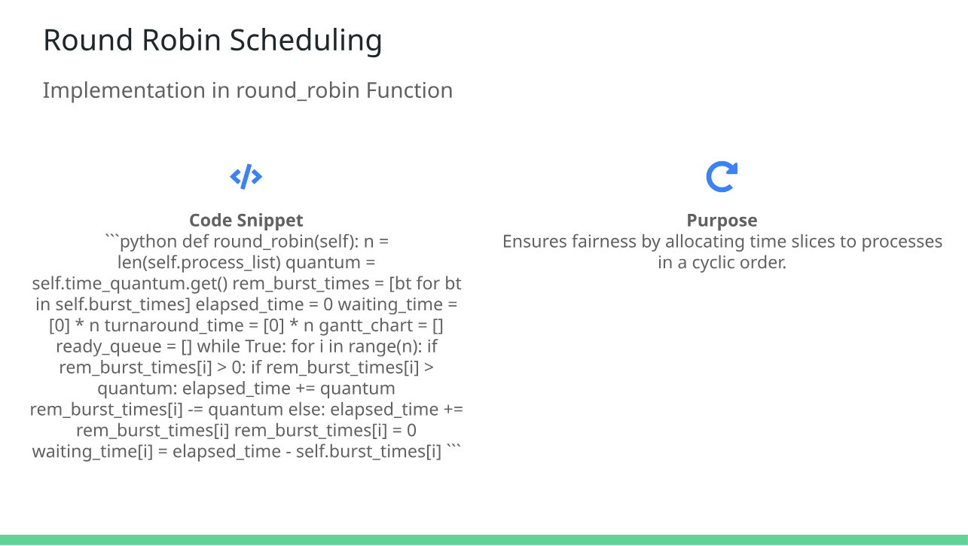

Slide 24
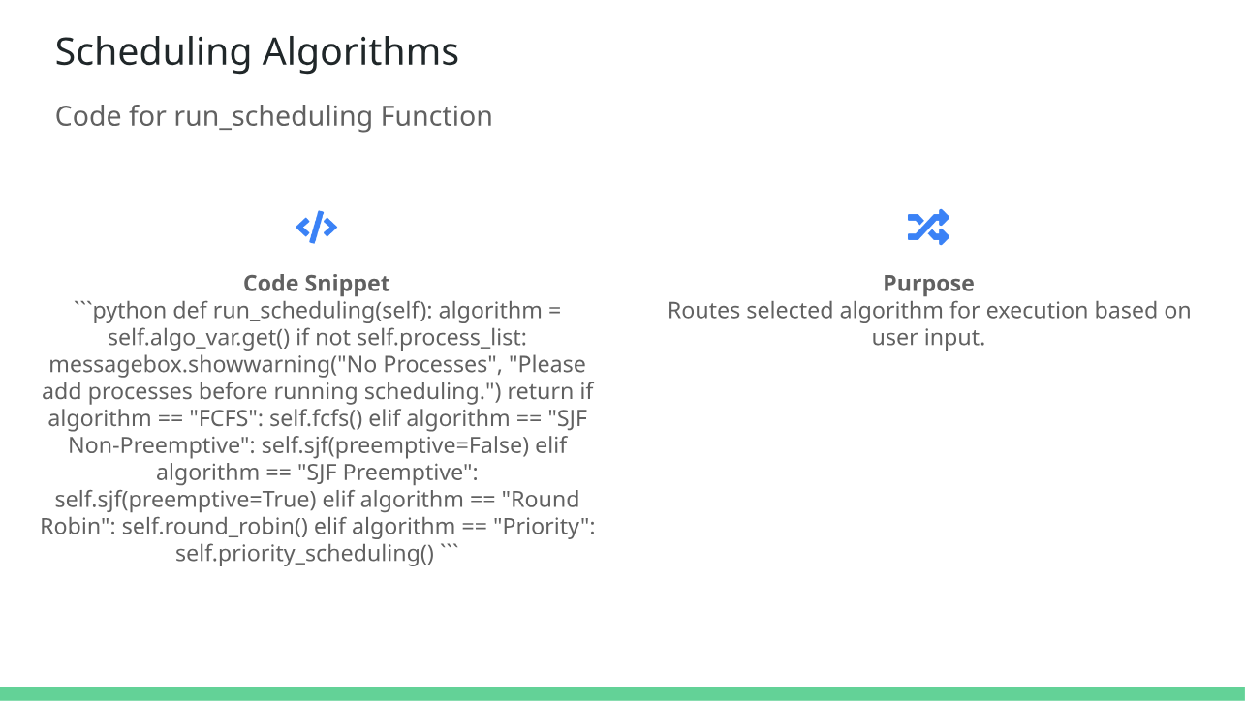

Slide 25
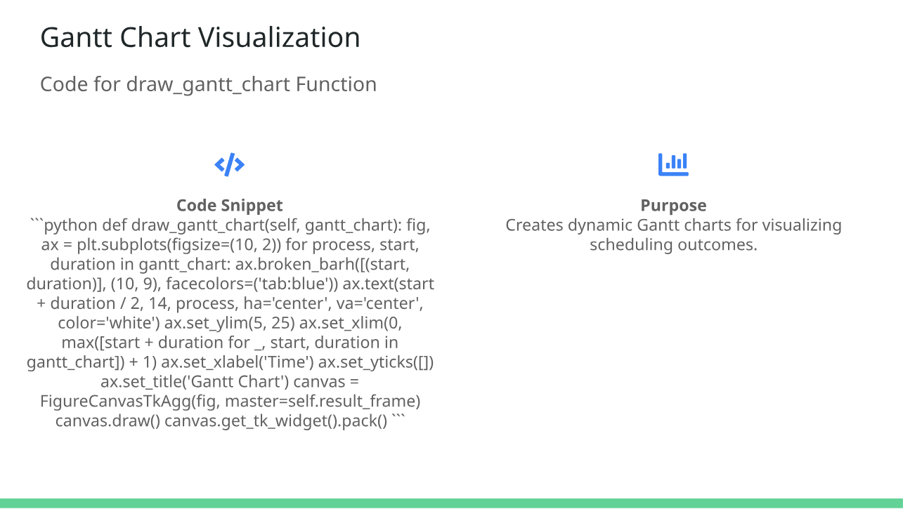

Slide 26
/*End of Code*/
Please text your queries to our group members at their respective email addresses.
[Emails attached in the start slide]

Slide 28
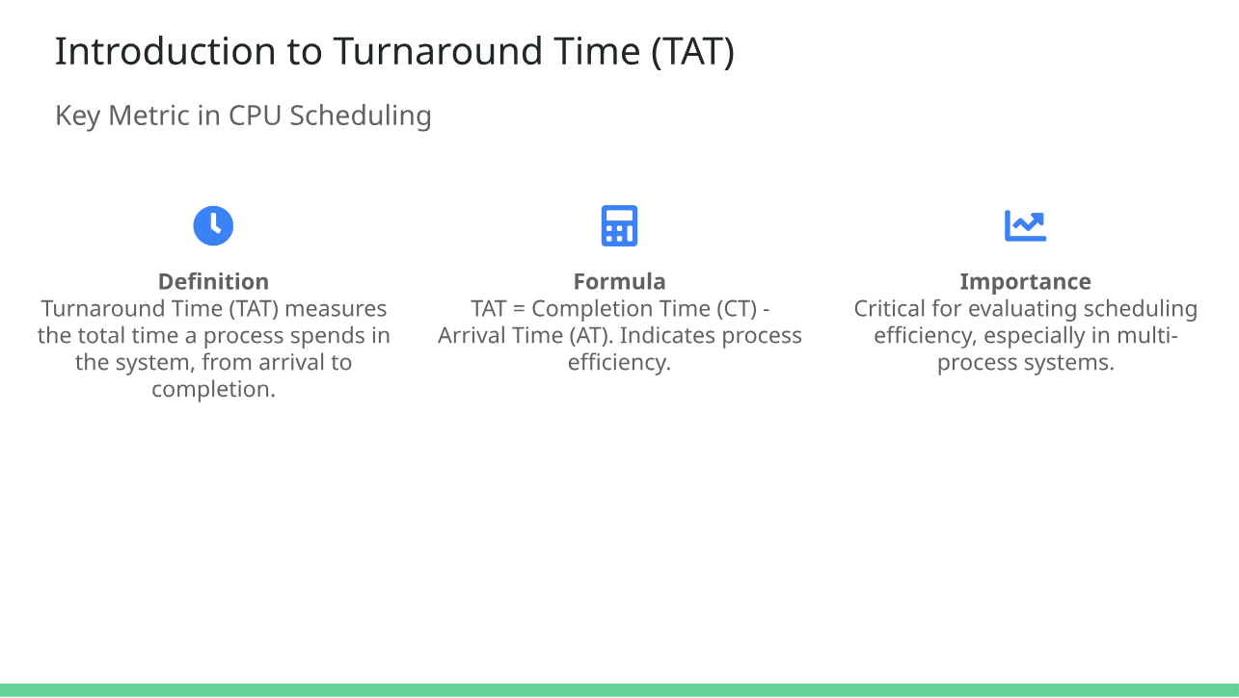

Slide 29
FCFS Output

Slide 30
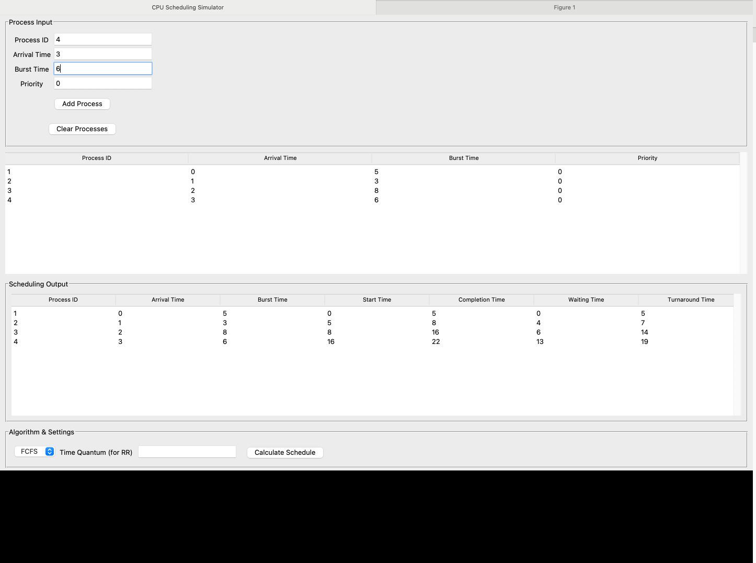

Slide 31
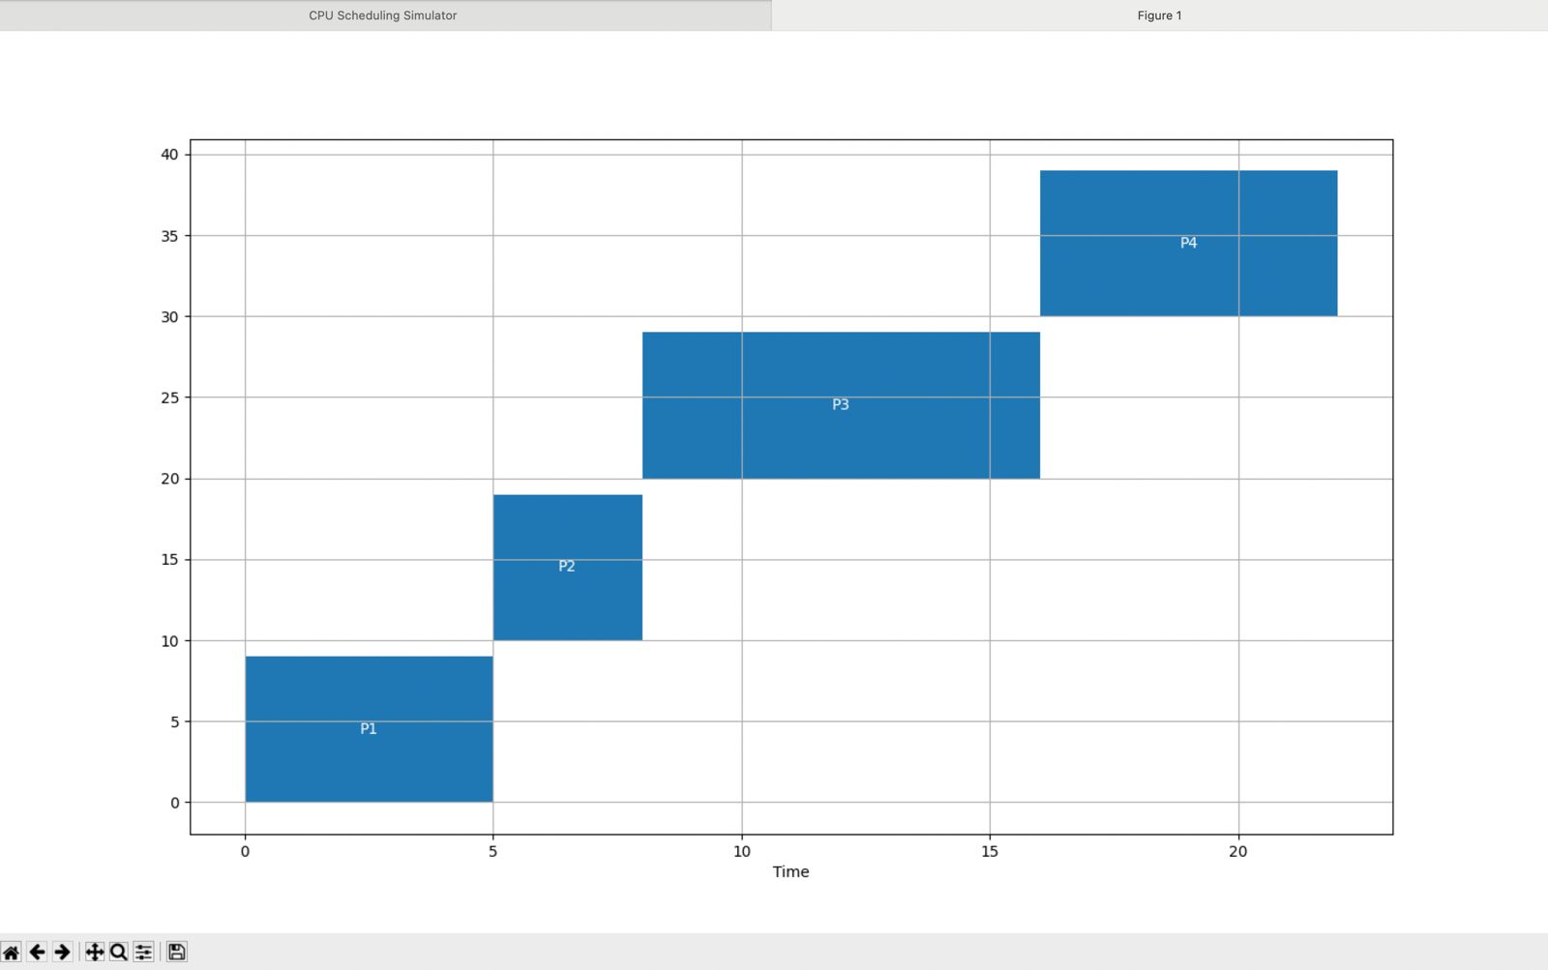

Slide 32
SJF Non Preemptive

Slide 33
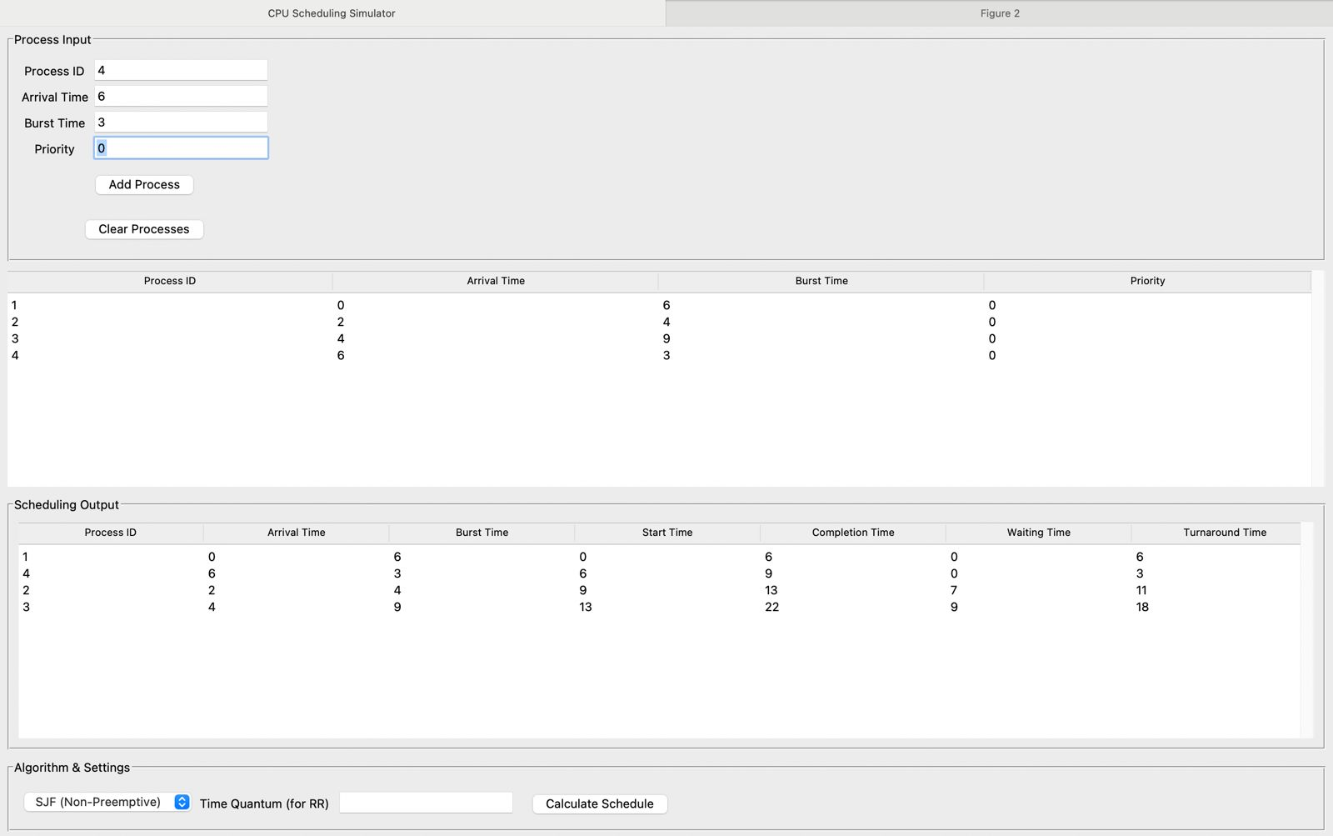

Slide 34
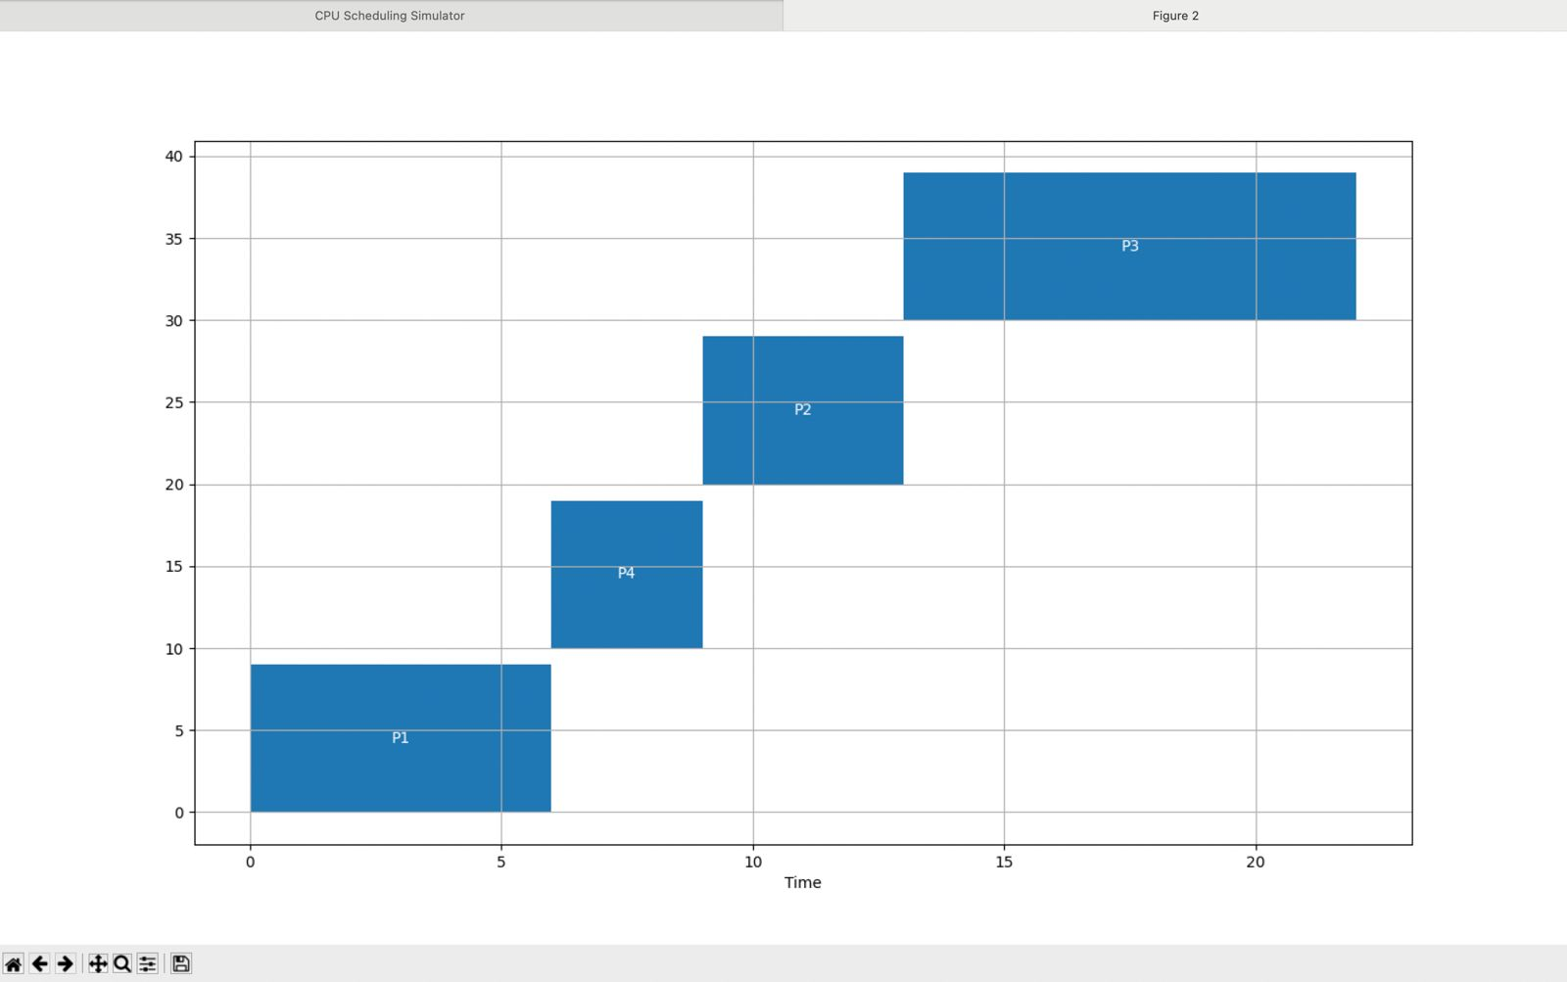

Slide 35
SJP Preemptive

Slide 36
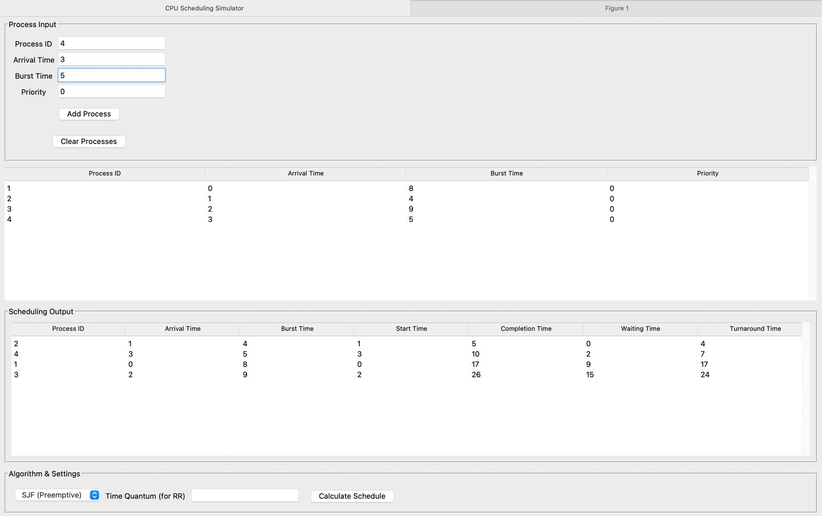

Slide 37
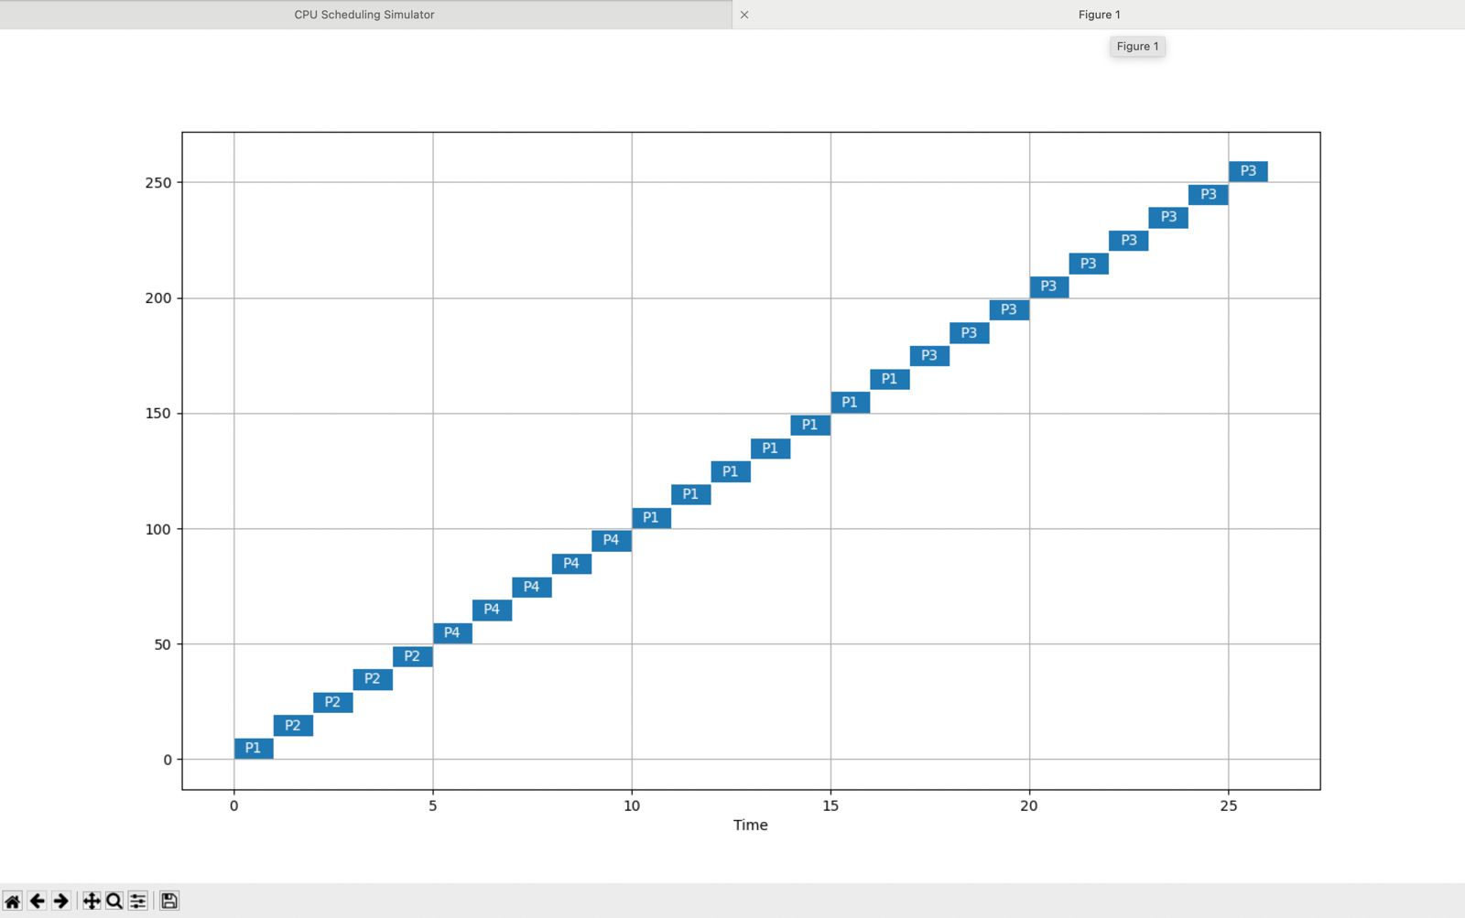

Slide 38
RR (Round Robin)

Slide 39
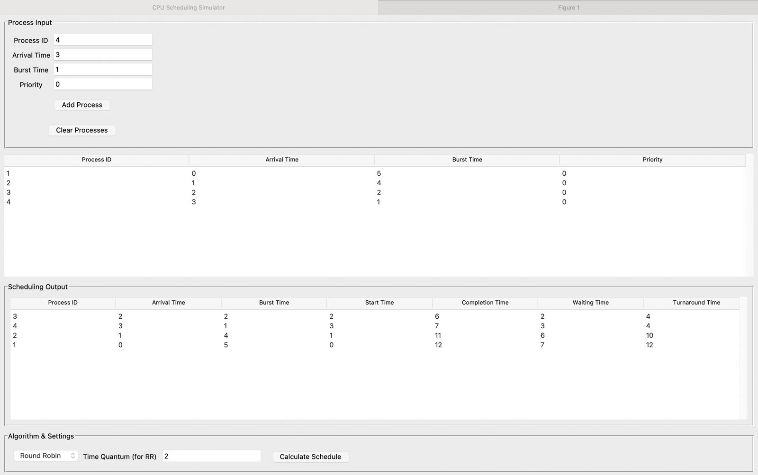

Slide 40
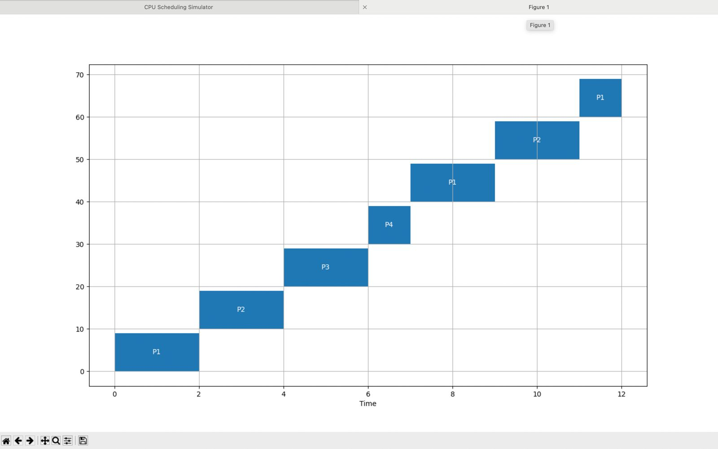

Slide 41
Priority Scheduling (Non-preemptive)

Slide 42
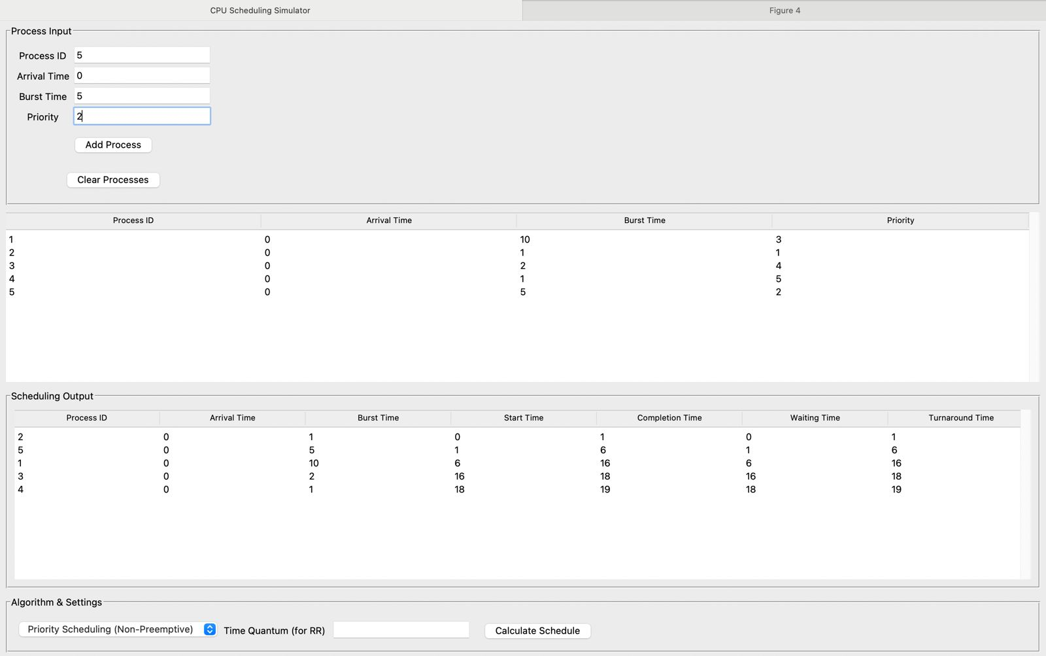

Slide 43
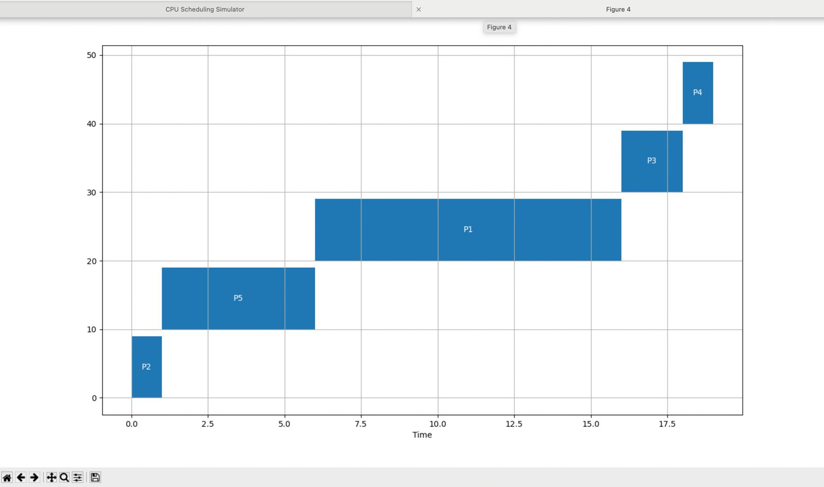

Slide 44
Preemptive Priority Scheduling

Slide 45
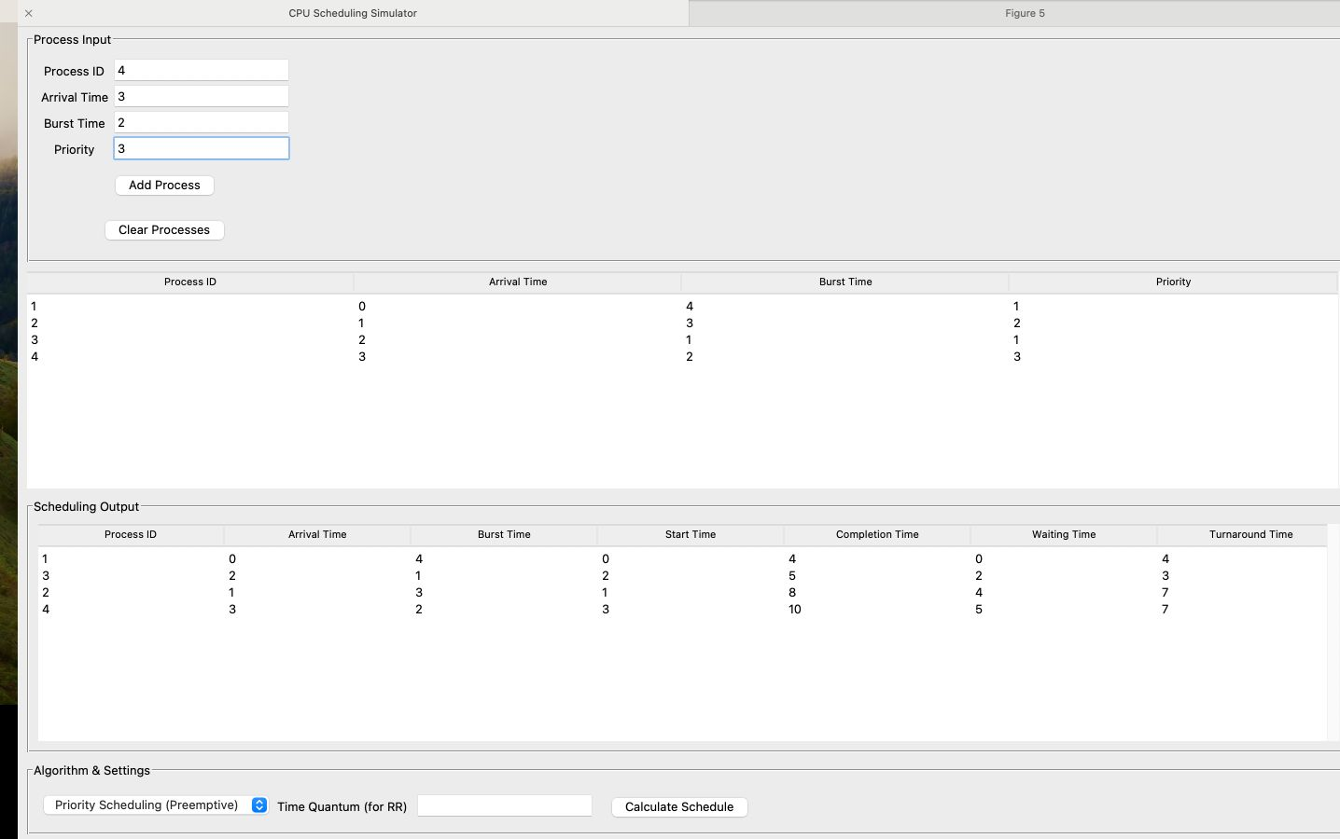

Slide 46
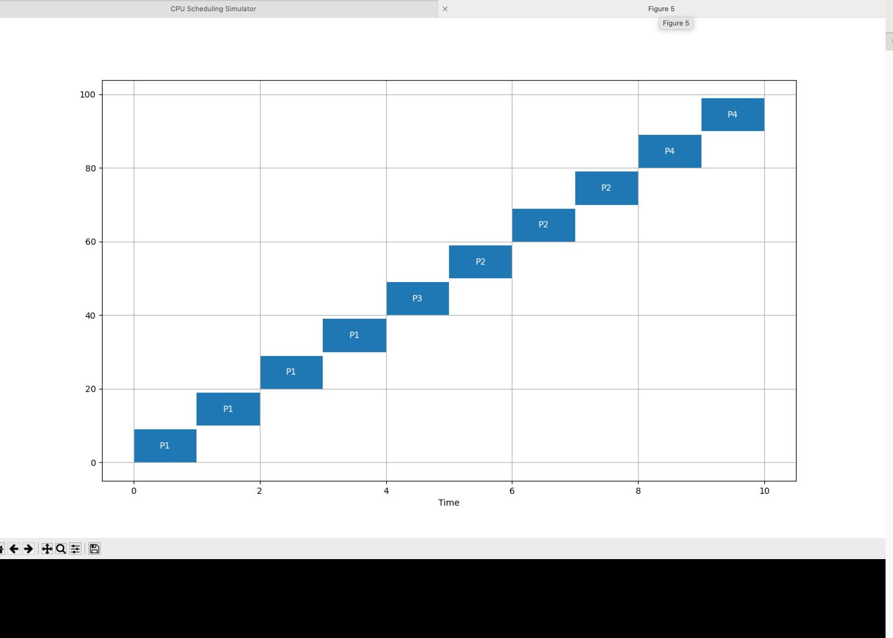

Slide 47
Thank you!

